Slide 1
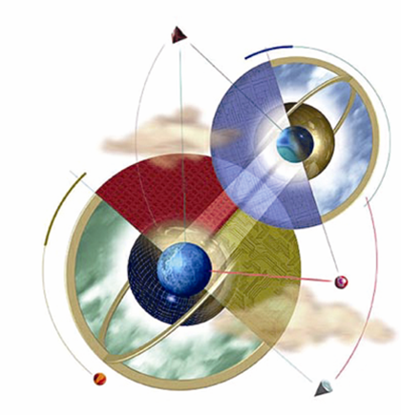
Introduction to Expert Systems

Slide 2
What is an expert system?
“An expert system is a computer system that emulates, or acts in all respects, with the decision-making capabilities of a human expert.”
Professor Edward Feigenbaum
Stanford University

Slide 3
What is an expert system?
“The expert systems are the computer applications developed to solve complex problems in a particular domain, at the level of extra-ordinary human intelligence and expertise.”

Slide 4
Capabilities of Expert Systems
The expert systems are capable of −
Advising
Instructing and assisting human in decision making
Demonstrating
Deriving a solution
Diagnosing
Explaining
Interpreting input
Predicting results
Justifying the conclusion
Suggesting alternative options to a problem

Slide 5
Capabilities of Expert Systems
They are incapable of −
Substituting human decision makers
Possessing human capabilities
Producing accurate output for inadequate knowledge base
Refining their own knowledge

Slide 6
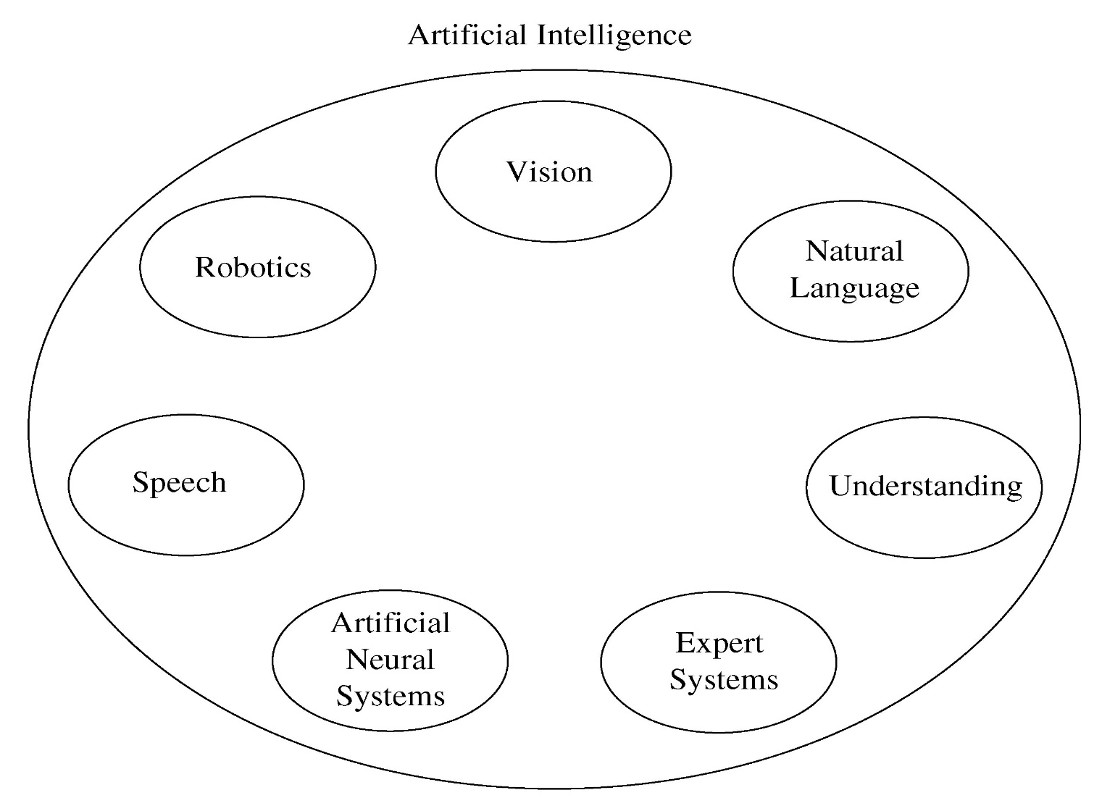
Fig 1.1 Areas of Artificial Intelligence

Slide 7
Expert System Main Components
The components of ES include −
Knowledge Base
Interface Engine
User Interface

Slide 8
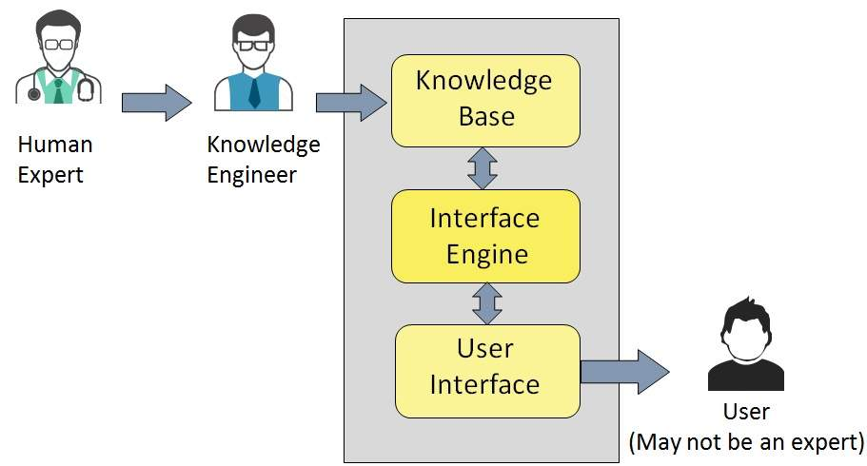
Expert System Main Components

Slide 9
Expert System Main Components
Knowledge Base
It contains domain-specific and high-quality knowledge. Knowledge is required to exhibit intelligence. The success of any ES majorly depends upon the collection of highly accurate and precise knowledge.

Slide 10
Expert System Main Components
What is Knowledge?
The data is collection of facts. The information is organized as data and facts about the task domain. Data, information, and past experience combined together are termed as knowledge.

Slide 11
Expert System Main Components
Knowledge representation
It is the method used to organize and formalize the knowledge in the knowledge base. It is in the form of IT-THEN-ELSE rules.
What are other ways to represent knowledge? Recall…

Slide 12
Expert System Main Components
Knowledge Acquisition
The success of any expert system majorly depends on the quality, completeness, and accuracy of the information stored in the knowledge base.
The knowledge base is formed by readings from various experts, scholars, and the Knowledge Engineers. The knowledge engineer is a person with the qualities of empathy, quick learning, and case analyzing skills.

Slide 13
Expert System Main Components
He acquires information from subject expert by recording, interviewing, and observing him at work, etc. He then categorizes and organizes the information in a meaningful way, in the form of IF-THEN-ELSE rules, to be used by interference machine. The knowledge engineer also monitors the development of the ES.

Slide 14
Expert System Main Components
Interface Engine
Use of efficient procedures and rules by the Interface Engine is essential in deducting a correct, flawless solution.
In case of knowledge-based ES, the Interface Engine acquires and manipulates the knowledge from the knowledge base to arrive at a particular solution.
In case of rule based ES, it −
Applies rules repeatedly to the facts, which are obtained from earlier rule application.
Adds new knowledge into the knowledge base if required.
Resolves rules conflict when multiple rules are applicable to a particular case.

Slide 15
Expert System Main Components
To recommend a solution, the interface engine uses the following strategies −
Forward Chaining
Backward Chaining

Slide 16
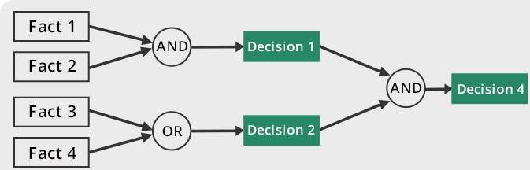
Expert System Main Components
Forward Chaining
Interpret and discuss what the above figure suggest?

Slide 17
Expert System Main Components
Forward Chaining
It is a strategy of an expert system to answer the question, “What can happen next?”
Here, the interface engine follows the chain of conditions and derivations and finally deduces the outcome. It considers all the facts and rules, and sorts them before concluding to a solution.
This strategy is followed for working on conclusion, result, or effect. For example, prediction of share market status as an effect of changes in interest rates.

Slide 18
Expert System Main Components
Forward Chaining
If we have are rule like:
If A B C then P
In your KB you have A,B,C as some facts then if above rule is true then P will now also be part of your KB
Data ------> Goal

Slide 19
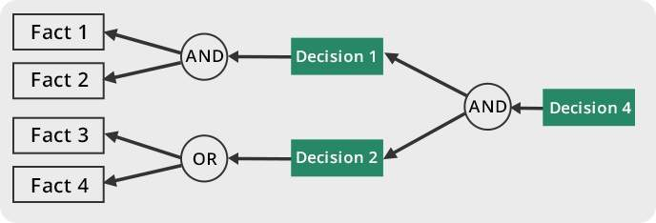
Expert System Main Components
Backward Chaining
Interpret and discuss what the above figure suggest?

Slide 20
Expert System Main Components
Backward Chaining
With this strategy, an expert system finds out the answer to the question, “Why this happened?”
On the basis of what has already happened, the interface engine tries to find out which conditions could have happened in the past for this result.
This strategy is followed for finding out cause or reason. For example, diagnosis of blood cancer in humans, identifying cause of allergy.

Slide 21
Expert System Main Components
Backward Chaining
If A B C then P
In your KB you have A,B as some facts & If X then C has been proved so X will also be part of KB.
You start with P and have A & B already in your KB , then you look for C but X is already in your KB so C is now part of KB
Goal -----> Data

Slide 22
Expert System Main Components
User Interface
User interface provides interaction between user of the ES and the ES itself. It is generally Natural Language Processing so as to be used by the user who is well-versed in the task domain. The user of the ES need not be necessarily an expert in Artificial Intelligence.
It explains how the ES has arrived at a particular recommendation. The explanation may appear in the following forms −
Natural language displayed on screen.
Verbal narrations in natural language.
Listing of rule numbers displayed on the screen.
The user interface makes it easy to trace the credibility of the deductions.

Slide 23
Expert System Main Components
http://en.akinator.mobi/personnages/jeu

Slide 24
Expert System Main Components
Requirements of Efficient ES User Interface
List a few Requirements of Efficient ES User Interface?

Slide 25
Expert System Main Components
It should help users to accomplish their goals in shortest possible way.
It should be designed to work for user’s existing or desired work practices.
Its technology should be adaptable to user’s requirements; not the other way round.
It should make efficient use of user input.

Slide 26
Expert System Main Components
Expert Systems Limitations
List few limitations?

Slide 27
Expert System Main Components
Expert Systems Limitations
No technology can offer easy and complete solution. Large systems are costly, require significant development time, and computer resources. ESs have their limitations which include −
Limitations of the technology
Difficult knowledge acquisition
ES are difficult to maintain
High development costs

Slide 28
Expert System Main Components
Applications of Expert System
The following table shows where ES can be applied.
Application | Description
Design Domain | Camera lens design, automobile design.
Medical Domain | Diagnosis Systems to deduce cause of disease from observed data, conduction medical operations on humans.
Monitoring Systems | Comparing data continuously with observed system or with prescribed behavior such as leakage monitoring in long petroleum pipeline.
Process Control Systems | Controlling a physical process based on monitoring.
Knowledge Domain | Finding out faults in vehicles, computers.
Finance/Commerce | Detection of possible fraud, suspicious transactions, stock market trading, Airline scheduling, cargo scheduling.

Slide 29
Knowledge Engineering
The process of building an expert system:
The knowledge engineer establishes a dialog with the human expert to elicit knowledge.
The knowledge engineer codes the knowledge explicitly in the knowledge base.
The expert evaluates the expert system and gives a critique to the knowledge engineer.

Slide 30
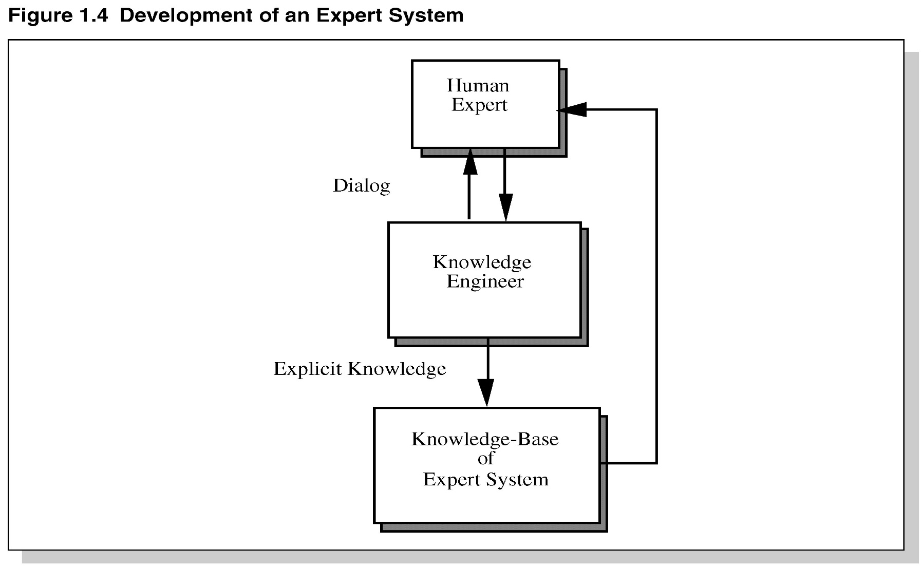
Development of an Expert System

Slide 31
Uncertainty
Both human experts and expert systems must be able to deal with uncertainty.

Slide 32
Limitations of Expert Systems
Typical expert systems cannot generalize through analogy to reason about new situations in the way people can.
A knowledge acquisition bottleneck results from the time-consuming and labor intensive task of building an expert system.

Slide 33
Early Expert Systems
DENDRAL – used in chemical mass spectroscopy to identify chemical constituents
MYCIN – medical diagnosis of illness
DIPMETER – geological data analysis for oil
PROSPECTOR – geological data analysis for minerals
XCON/R1 – configuring computer systems

Slide 34
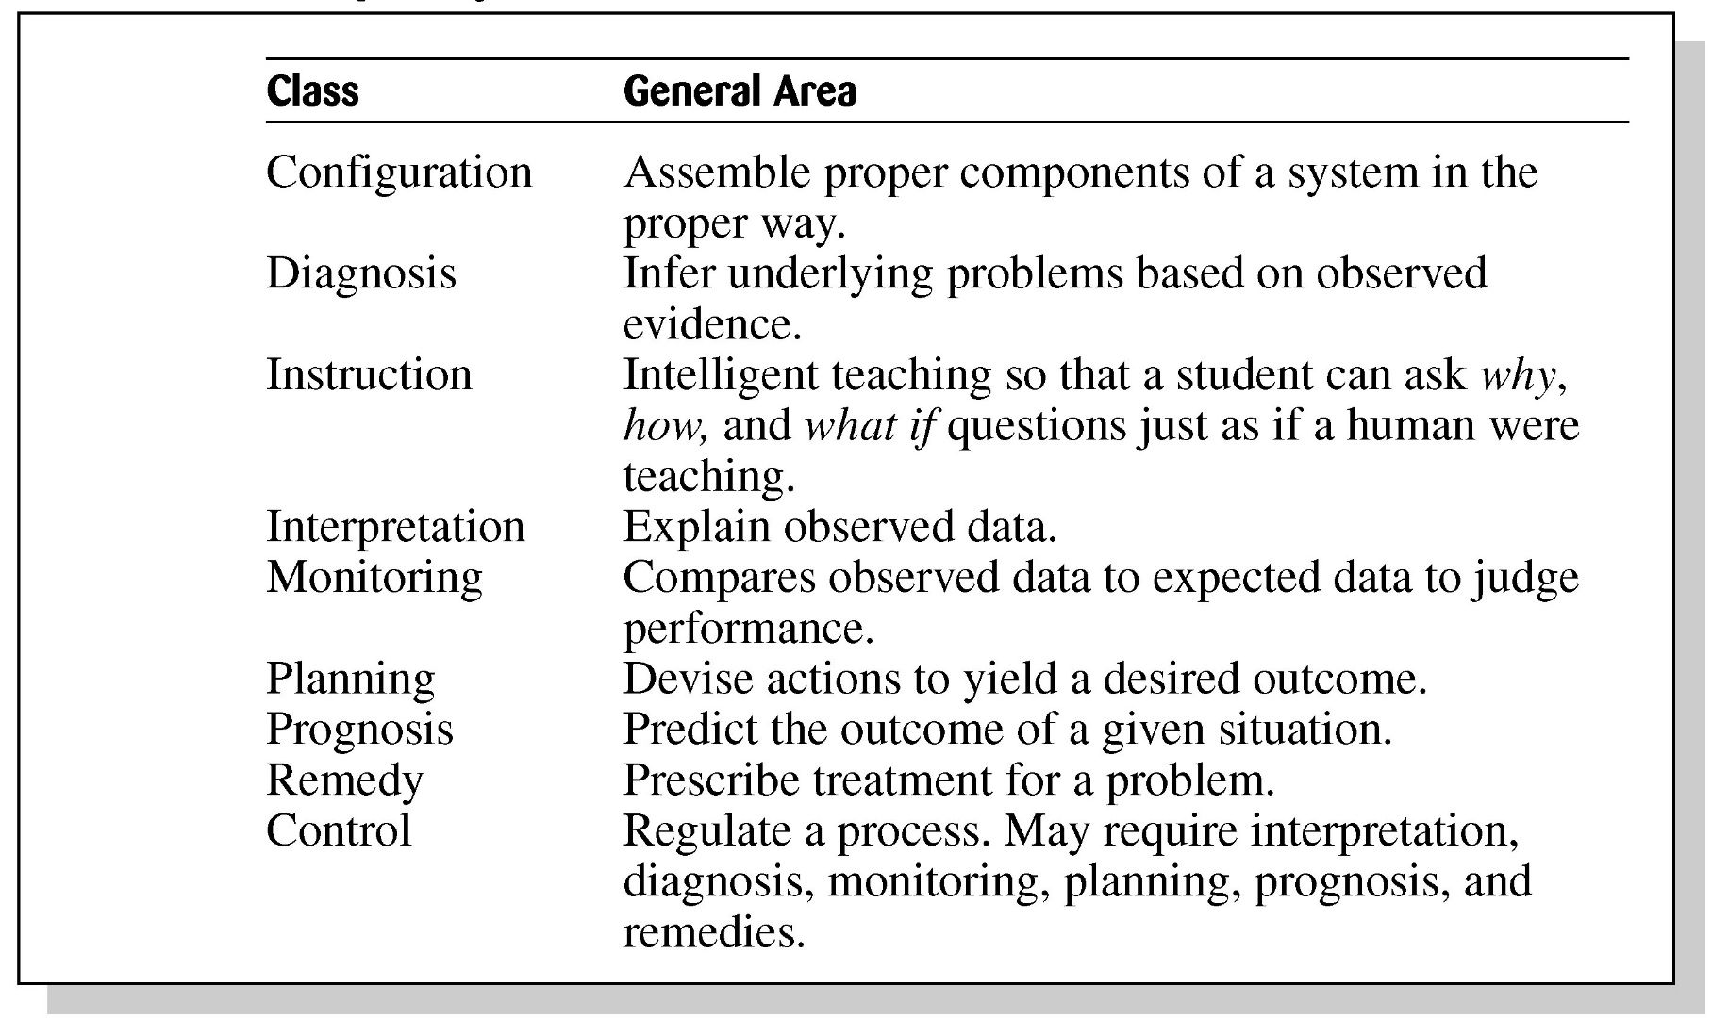
Table 1.3 Broad Classes of Expert Systems

Slide 35
Problems with Algorithmic Solutions
Conventional computer programs generally solve problems having algorithmic solutions.
Algorithmic languages include C, Java, and C#.
Classical AI languages: eg: PROLOG.

Slide 36
Considerations for Building Expert Systems
Can the problem be solved effectively by conventional programming?
Is there a need and a desire for an expert system?
Is there at least one human expert who is willing to cooperate?
Can the expert explain the knowledge to the knowledge engineer can understand it.
Is the problem-solving knowledge mainly heuristic and uncertain?

Slide 37
Languages, Shells, and Tools
Expert system languages are post-third generation.
Procedural languages (e.g., C) focus on techniques to represent data.
More modern languages (e.g., Java) focus on data abstraction.
Expert system languages/TOOLS (e.g. CLIPS) focus on ways to represent knowledge.

Slide 38
Languages, Shells, and Tools
For Information:
Developed at NASA's Johnson Space Center from 1985 to 1996, the 'C' Language Integrated Production System (CLIPS) is useful for creating expert systems and other programs.
Written in C for portability, CLIPS can be installed and used on a wide variety of platforms. Since 1996, CLIPS has been available as public domain software.

Slide 39
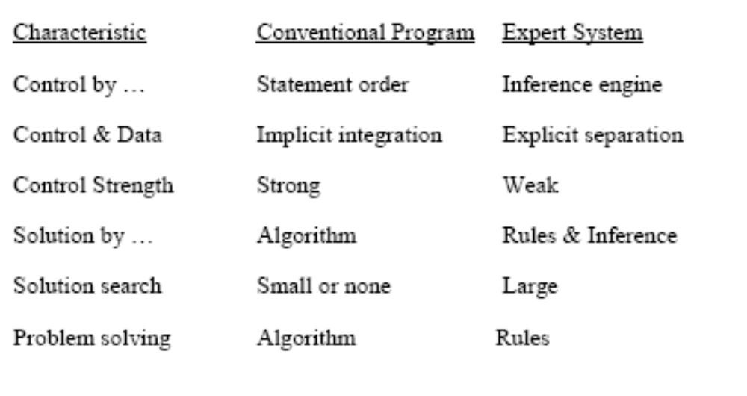
Expert systems Vs conventional programs I

Slide 40
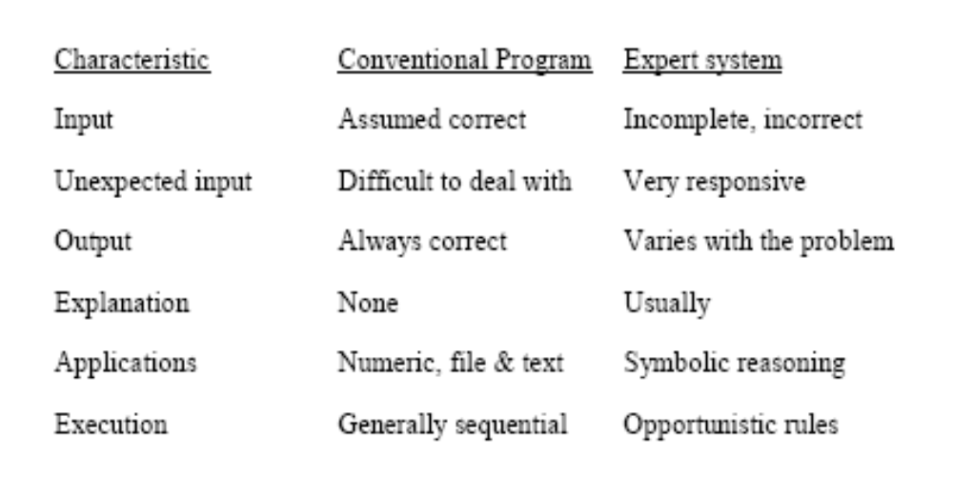
Expert systems Vs conventional programs II

Slide 41
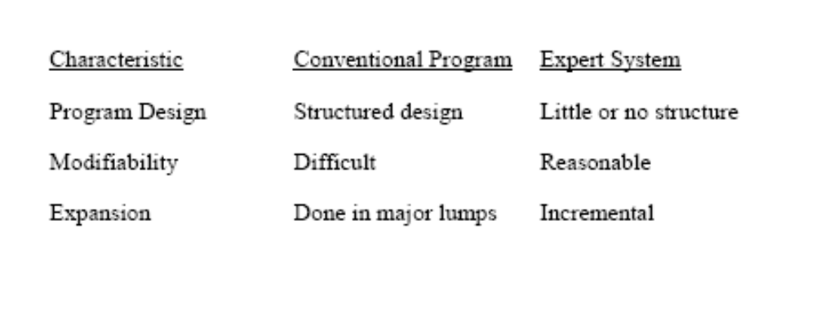
Expert systems Vs conventional programs III

Slide 42
Expert System Shell
Knowledge Representation
Reasoning
Explanation

Slide 43
Elements of an Expert System
User interface – mechanism by which user and system communicate.
Exploration facility – explains reasoning of expert system to user.
Working memory – global database of facts used by rules.
Inference engine – makes inferences deciding which rules are satisfied and prioritizing.

Slide 44
Elements Continued
Agenda – a prioritized list of rules created by the inference engine, whose patterns are satisfied by facts or objects in working memory.
Knowledge acquisition facility – automatic way for the user to enter knowledge in the system bypassing the explicit coding by knowledge engineer.
Knowledge Base – includes the rules of the expert system

Slide 45
Production Rules
Knowledge base is also called production memory.
Production rules can be expressed in IF-THEN pseudocode format.
In rule-based systems, the inference engine determines which rule antecedents are satisfied by the facts.

Slide 46
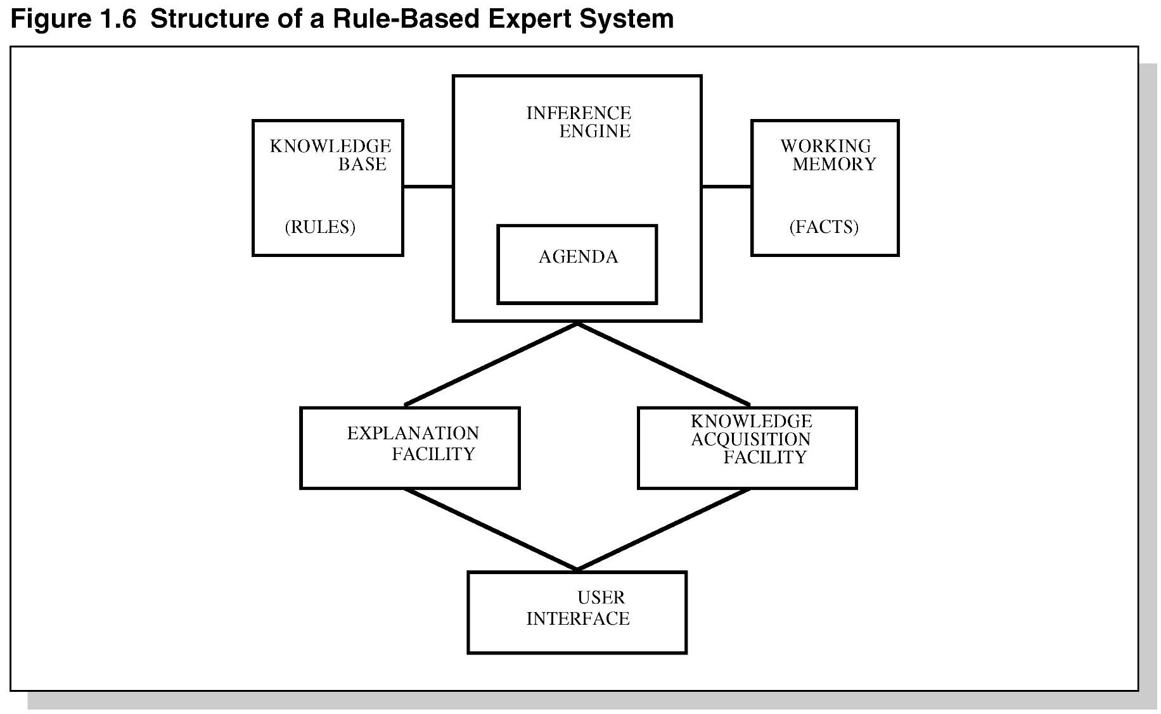
Figure 1.6 Structure of a
Rule-Based Expert System

Slide 47
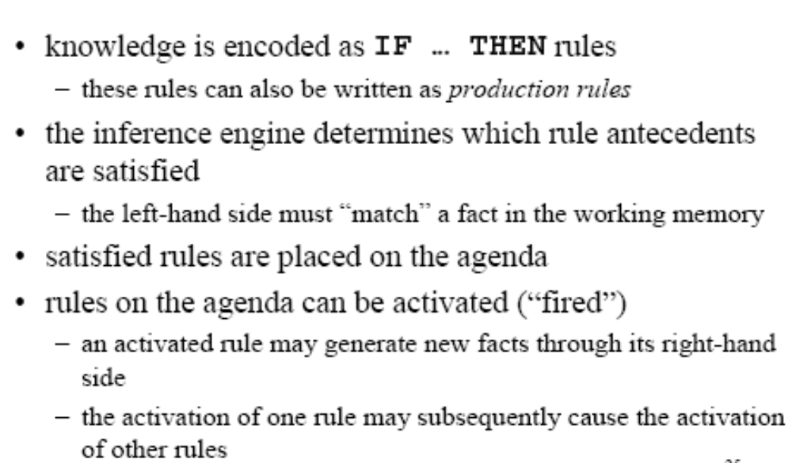
Rule-Based ES

Slide 48
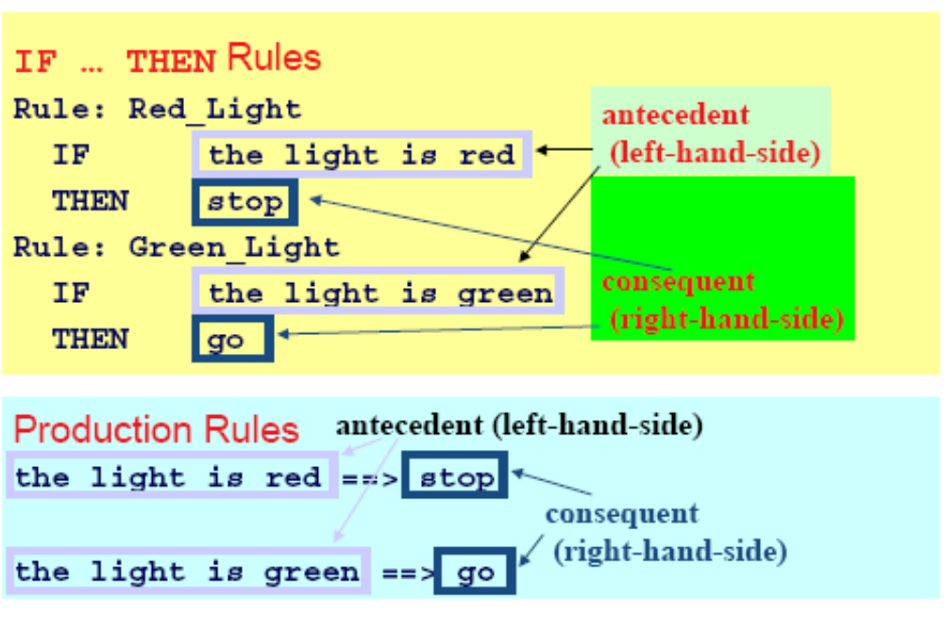
Example Rules

Slide 49
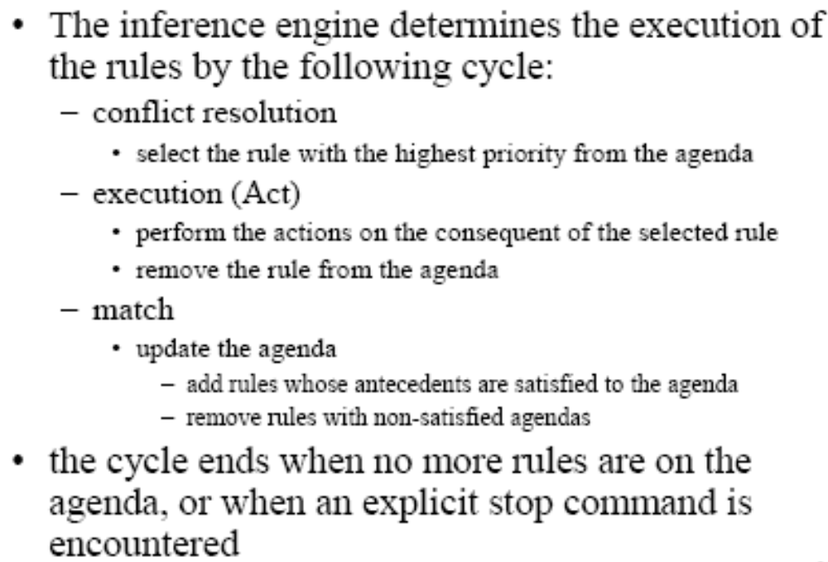
Inference Engine Cycle

Slide 50
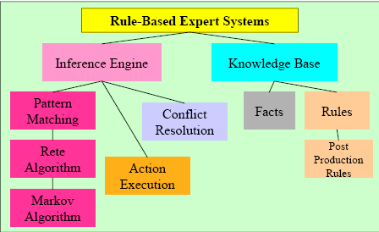
Foundation of Expert Systems

Slide 51
General Methods of Inferencing
Forward chaining (data-driven)– reasoning from facts to the conclusions resulting from those facts – best for prognosis, monitoring, and control.
  Examples: CLIPS, OPS5
Backward chaining (query/Goal driven)– reasoning in reverse from a hypothesis, a potential conclusion to be proved to the facts that support the hypothesis – best for diagnosis problems.
  Examples: MYCIN

Slide 52
Production Systems
Rule-based expert systems – most popular type today.
Knowledge is represented as multiple rules that specify what should/not be concluded from different situations.
Forward chaining – start w/facts and use rules do draw conclusions/take actions.
Backward chaining – start w/hypothesis and look for rules that allow hypothesis to be proven true.

Slide 53
Post Production System
Basic idea – any mathematical / logical system is simply a set of rules specifying how to change one string of symbols into another string of symbols.
    these rules are also known as rewrite rules
    simple syntactic string manipulation
    no understanding or interpretation is required\also used to define grammars of languages
      e.g BNF grammars of programming languages.
Basic limitation – lack of control mechanism to guide the application of the rules.

Slide 54
Markov Algorithm
An ordered group of productions applied in order or priority to an input string.
If the highest priority rule is not applicable, we apply the next, and so on.
inefficient algorithm for systems with many rules.
Termination on (1) last production not applicable to a string, or (2) production ending with period applied
Can be applied to substrings, beginning at left

Slide 55
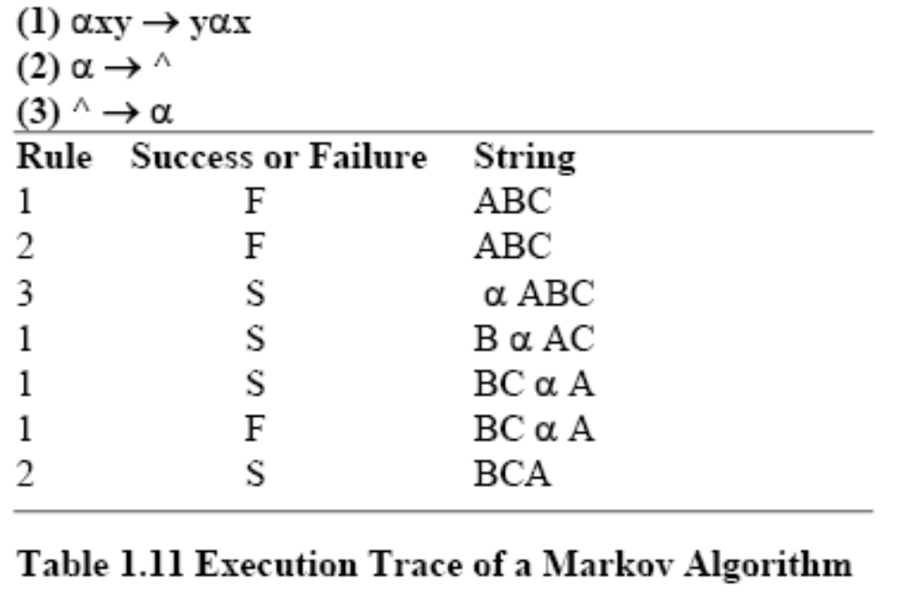
Markov Algorithm

Slide 56
Rete Algorithm
Markov: too inefficient to be used with many rules
Functions like a net – holding a lot of information.
Much faster response times and rule firings can occur compared to a large group of IF-THEN rules which would have to be checked one-by-one in conventional program.
Takes advantage of temporal redundancy and structural similarity.
Looks only for changes in matches (ignores static data)
Drawback is high memory space requirements.

Slide 57
Procedural Paradigms
Algorithm – method of solving a problem in a finite number of steps.
Procedural programs are also called sequential programs.
The programmer specifies exactly how a problem solution must be coded.

Slide 58
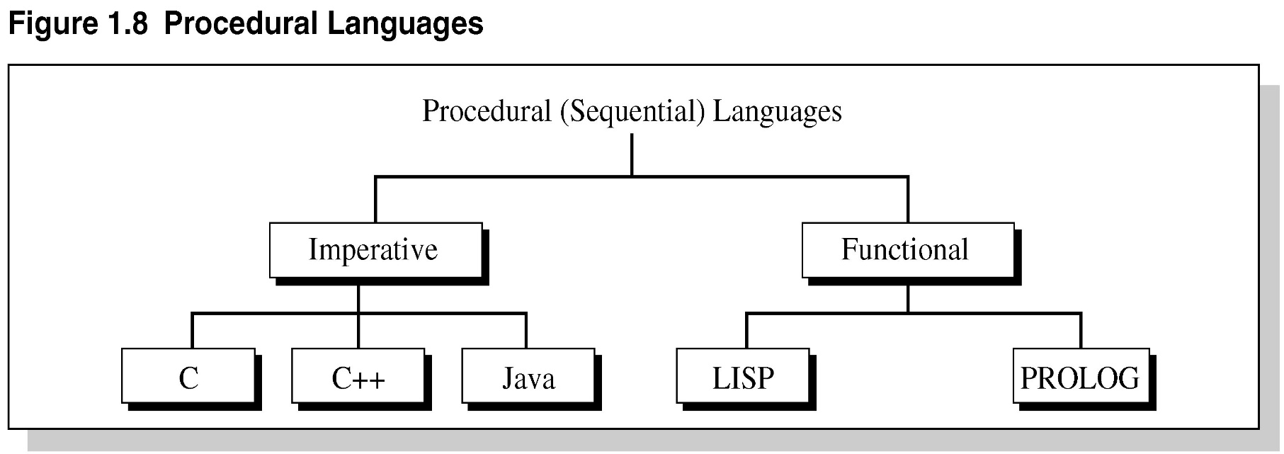
Figure 1.8 Procedural Languages

Slide 59
Imperative Programming
Also known as statement-oriented
During execution, program makes transition from the initial state to the final state by passing through series of intermediate states.
Provide rigid control and top-down-design.
Not efficient for directly implementing expert systems.

Slide 60
Functional Programming
Function-based (association, domain, co-domain); f: S→ T
Not much control
Bottom-up→ combine simple functions to yield more powerful functions.
Mathematically a function is an association or rule that maps members of one set, the domain, into another set, the codomain.
e.g. LISP and Prolog

Slide 61
Nonprocedural Paradigms
Do not depend on the programmer giving exact details how the program is to be solved.
Declarative programming – goal is separated from the method to achieve it.
Object-oriented programming – partly imperative and partly declarative – uses objects and methods that act on those objects.
Inheritance – (OOP) subclasses derived from parent classes.

Slide 62
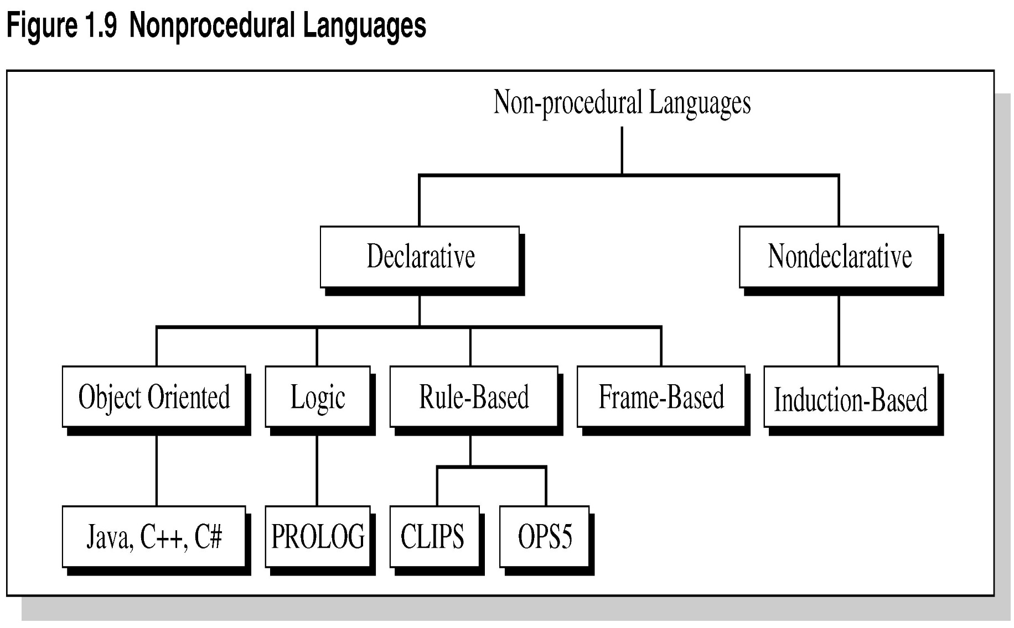
Figure 1.9 Nonprocedural Languages

Slide 63
What are Expert Systems?
Can be considered declarative languages:
Programmer does not specify how to achieve a goal at the algorithm level.
Induction-based programming – the program learns by generalizing from a sample.

Slide 64
Artificial Neural Systems
In the 1980s, a new development in programming paradigms appeared called artificial neural systems (ANS).
Based on the way the brain processes information.
Models solutions by training simulated neurons connected in a network.
ANS are found in face recognition, medical diagnosis, games, and speech recognition.

Slide 65
ANS Characteristics
A complex pattern recognition problem –computing the shortest route through a given list of cities.
ANS is similar to an analog computer using simple processing elements connected in a highly parallel manner.
Processing elements perform Boolean / arithmetic functions in the inputs
Key feature is associating weights w/each element.

Slide 66
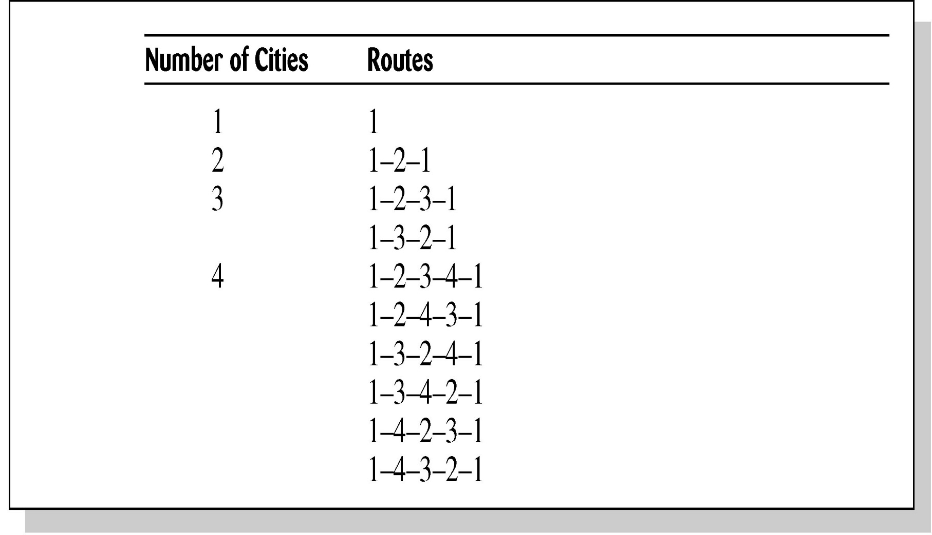
Table 1.13 Traveling
Salesman Problem

Slide 67
Advantages of ANS
Storage is fault tolerant
Quality of stored image degrades gracefully in proportion to the amount of net removed.
Nets can extrapolate (extend) and interpolate (insert/estimate) from their stored information.
Nets have plasticity.
Excellent when functionality is needed long-term w/o repair in hostile environment – low maintenance.

Slide 68
Disadvantage of ANS
ANS are not well suited for number crunching or problems requiring optimum solution.

Slide 69
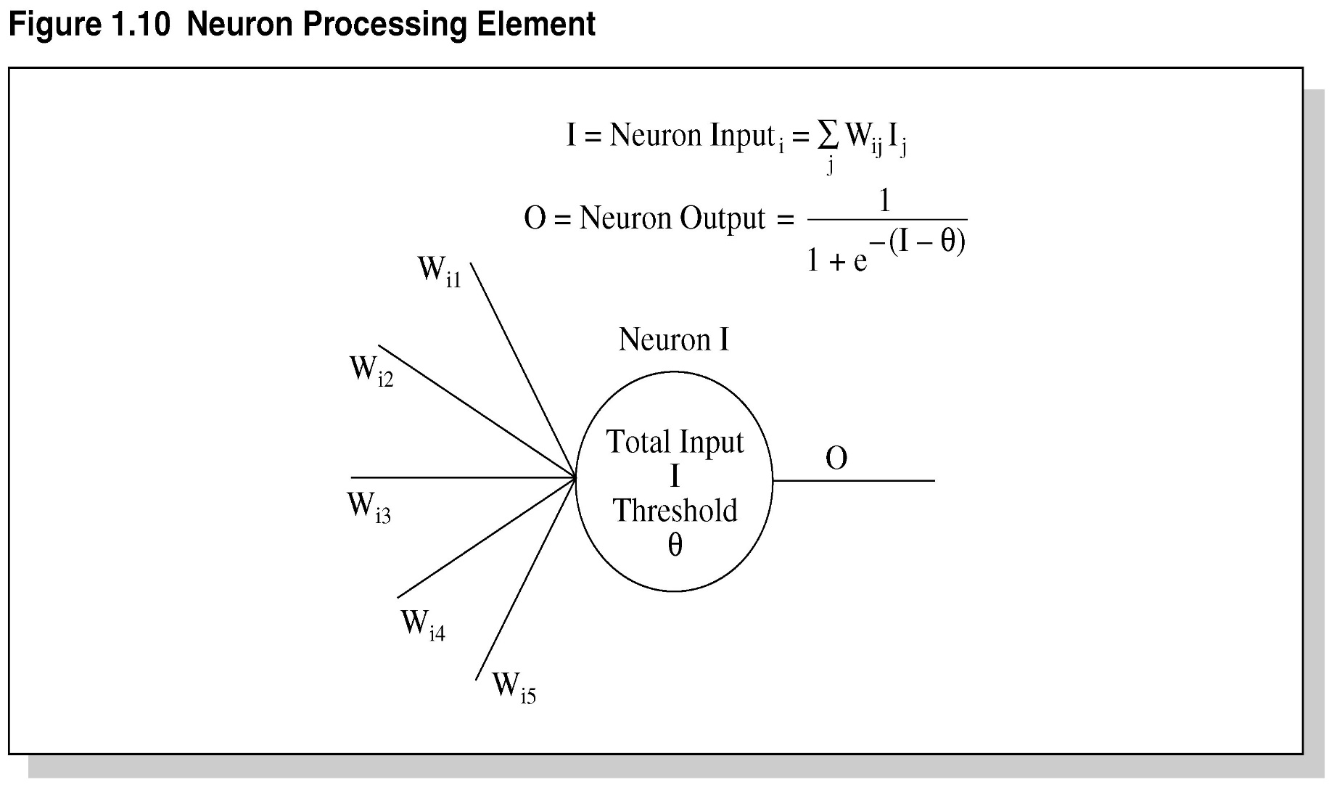
Figure 1.10 Neuron
Processing Element

Slide 70
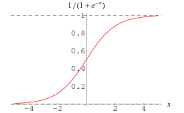
Sigmoid Function

Slide 71
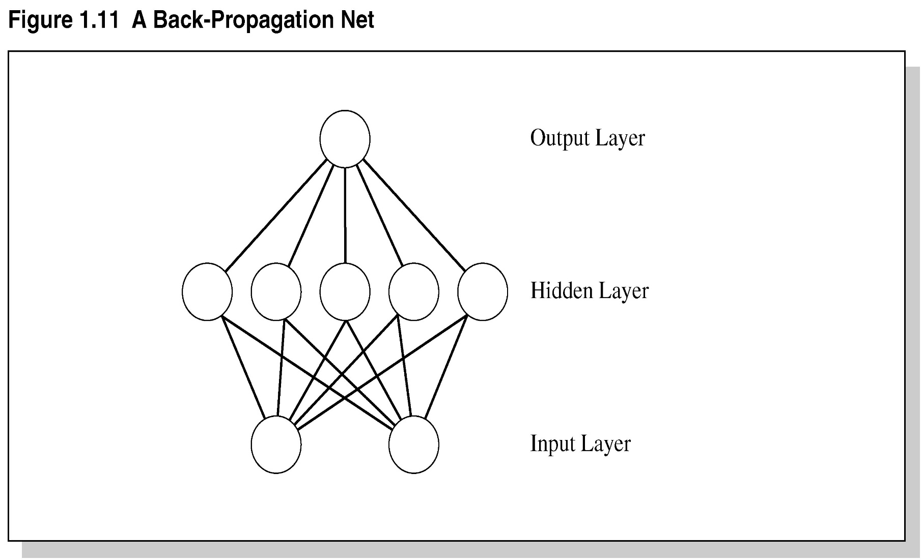
Figure 1.11 A
Back-Propagation Net

Slide 72
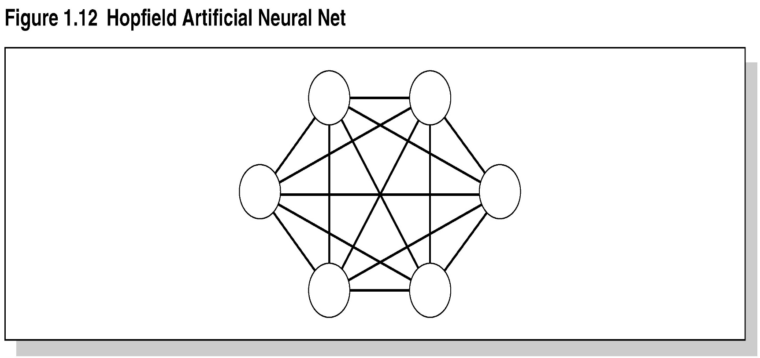
Figure 1.12 Hopfield
Artificial Neural Net

Slide 73
MACIE
An inference engine called MACIE (Matrix Controlled Inference Engine) uses ANS knowledge base.
Designed to classify disease from symptoms into one of the known diseases the system has been trained on.
MACIE uses forward chaining to make inferences and backward chaining to query user for additional data to reach conclusions.

Slide 74
Summary
During the 20th Century various definitions of AI were proposed.
In the 1960s, a special type of AI called expert systems dealt with complex problems in a narrow domain, e.g., medical disease diagnosis.
Today, expert systems are used in a variety of fields.
Expert systems solve problems for which there are no known algorithms.

Slide 75
Summary Continued
Expert systems are knowledge-based – effective for solving real-world problems.
Expert systems are not suited for all applications.
Future advances in expert systems will hinge on the new quantum computers and those with massive computational abilities in conjunction with computers on the Internet.

